Slide 1
POWER FACTOR CORRECTION
GROUP

Slide 2
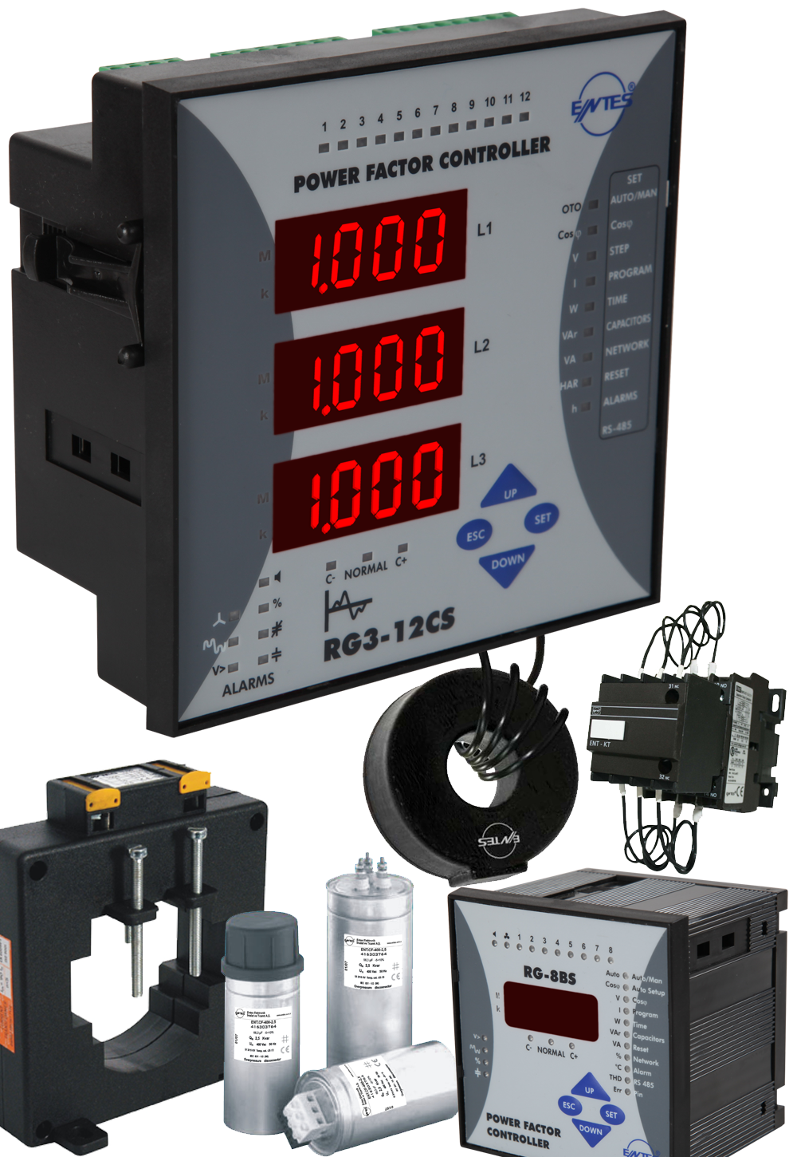
Power Factor Correction
Power factor controllers
Capacitors
Shunt reactors
Detuned filter reactors
Capacity duty contactors
Current transformers
Discharge units

Slide 3
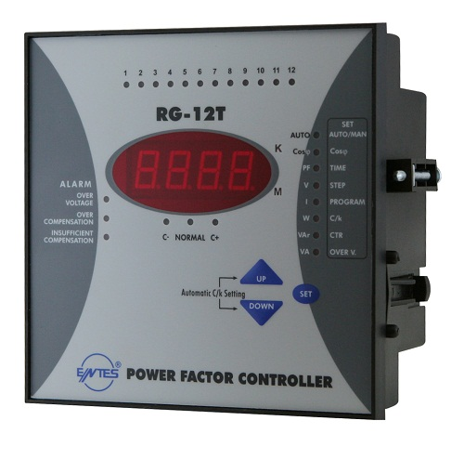
Power Factor Controllers RG-T Series
Features
Single phase measurement over single CT
Linear switching
Display of Cosφ, P, Q, S, Urms, Irms
5,6,8 and12 step options
Degree of protection: IP40 (IP 54 optional)

Slide 4
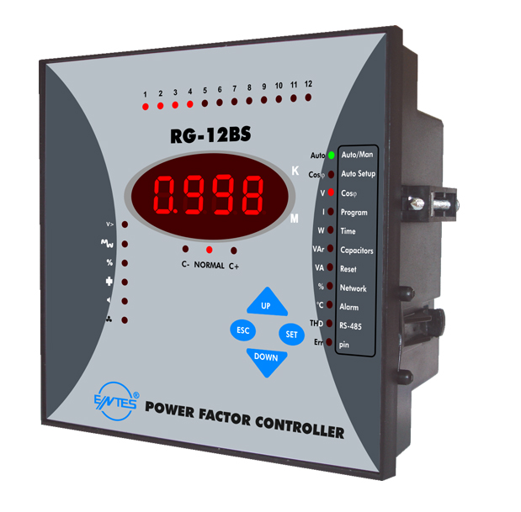
Power Factor Controllers RG-B Series
Features
Single phase measurement over single CT
Linear/Smart switching
Display of Cosφ, P, Q, S, Urms, Irms, THD V%, THD I%
THD-V and THD-I harmonic values upto 19th
8 and 12 step options
Internal temperature protection
RS-485 Modbus RTU communication (Optional)

Slide 5
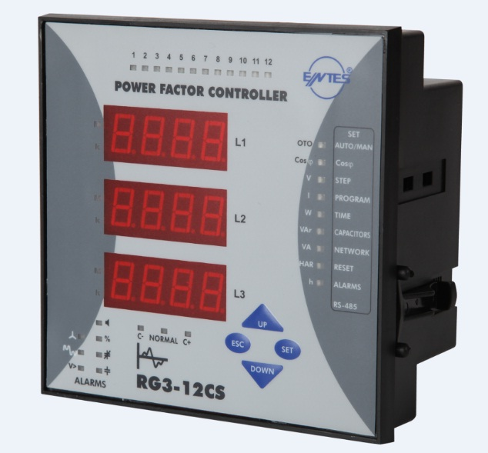
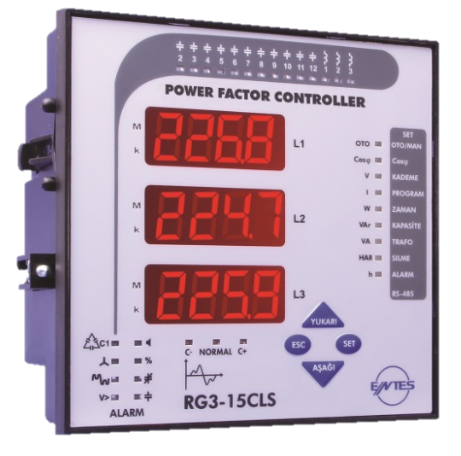
Power Factor Controllers RG3-C Series
Features
Three phase compensation
Linear/Smart switching
Display of Cosφ, P, Q, S, Urms, Irms, THD V%, THD I%, $\sum{P}$, $\sum{Q}$, $\sum{S}$, kWh, kVArh
THD-V and THD-I harmonic values upto 19th
Mono-phase capacitor step option
Additional shunt reactor step option
RS-485 Modbus RTU communication (Optional)
Internal and external temperature protection (optional)

Slide 6
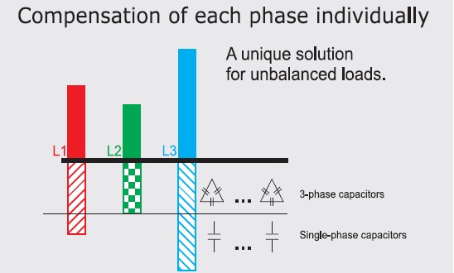
RG-B & RG-3 Series
Features cont’d
10 Different program options for step sequence
Mono-phase capacitor steps (RG3 Series)
Programming the energy counter value as on the system’s energy meter (RG3 Series)
Automatic connection recognition mode (RG3 series)
Programmable energy ratio percent alarm between 1-240 hours.
Internaly detecting and fixing misconnections

Slide 7
RG Series
Measured Parameters

Slide 8
Communication
RS-485 Modbus RTU communication

Slide 9
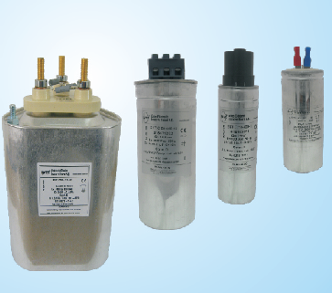
Low Voltage Power Capacitors ENT-C10/CXD/C100 Series
Features
Three phase capacitors
Voltage range: 400-415-440-450-500 V
Reactive power range:1-1,5-2,5 kVar ( C10 Series) 5-7,5-10-12,5-15-20-25-30 kVar (CXD Series) 5-10-12,5-20-25-30-50 kVar (C100 Series)
Life expectancy: 11000 hours ( C10/CXD Series) C100 Series:$>$15000 hours (oil),$>$ 13000 hours (dry)
Capacitor tolerance: -%5 +%10 (C10/CXD Series) ± %5 (C100 Series)

Slide 10
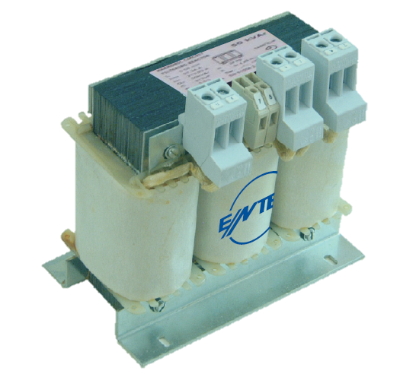
Shunt Reactors ENT-ERS Series
Features
Single and three phase reactors
Suppy voltage: 230V (1~) - 400V (3 ~)
Reactive power range: 0,25-0,5-1-1,5-2,5 (1~) 0,5-1-1,5-2-2,5-3-5-7,5-10-20-25-40-50 (3~)

Slide 11
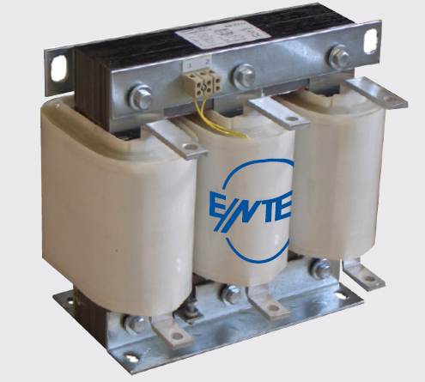
Detuned Filter Reactors ENT.ERH Series
Features
Single or three phase filters
Reactive power range: (1,5 – 100) kVar
P(fr) factor | Resonance frequency for 50hz | Minimum capacitor voltage
%5,67 | 210 Hz | 424 V
%7 | 189 Hz | 189 V
%14 | 134 Hz | 465 V

Slide 12
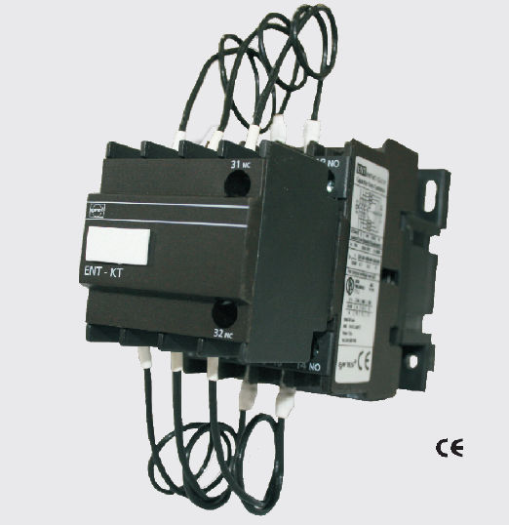
Capacitor Duty Contactors ENT-KT Series
Features
3 phase connection
415 V AC rating
Capacitor range: 2,5-60 kVar
Electrical life at rated load: 10000-20000 operations (optional)

Slide 13
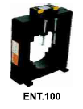
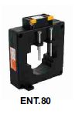
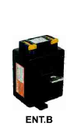
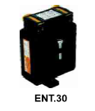
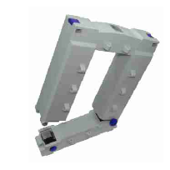
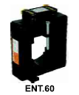
Low Voltage Current Transformers ENT-ENS Series
ENT-Series
Primary current: 5 – 5000 A (optional)
Nominal power: 5 – 30 VA (optional)
Class 0,5 (ENT 30 Class 1)
ENS-Series
Split core current transformers
Primary current: 100 –4000 A (optional)
Nominal power: 1.25 – 30 VA (optional)
Class 0,5 ( ENS.AYS 23/58 Class 1)
CT-25
Ratio: 1/2500
Class 1

Slide 14
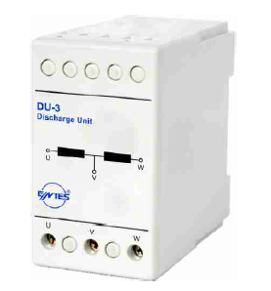
Discharge Unit DU-3
Features
Coil resistor: 3000 Ω
Nominal voltage: 230… 500 V
Operating period: Continuous
Reactive Power | Discharge Period (sec.)
Q(kVar) | 230 | 400 | 450
10 | 4 | 2 | 2
20 | 8 | 3,5 | 3
25 | 10 | 4 | 4
30 | 12 | 5,5 | 5
50 | 20 | 8 | 6

Slide 15
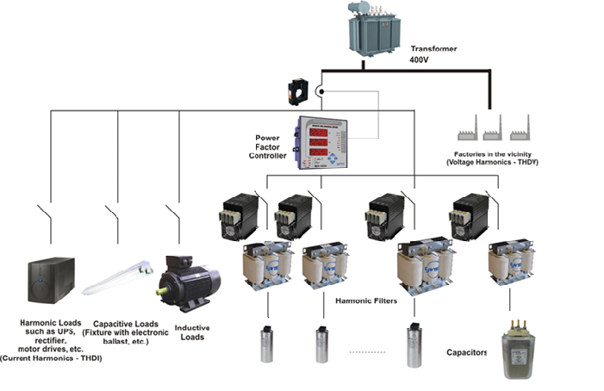
Static Contactors on a System
Appropriate harmonic filter reactors must be used in systems with harmonics.

Slide 16
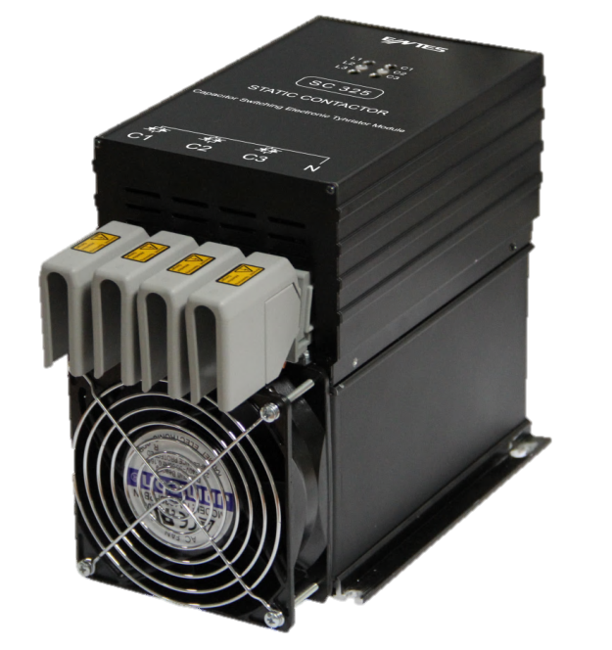
Static Contactors
 | 25 kVAr | 50 kVAr
Triangle with 2 thyristors (400 V) (without fan) | SC-225 | SC-250
Star with 3 thyristors (690 V) (with fan) | SC-325 | SC-350

Slide 17
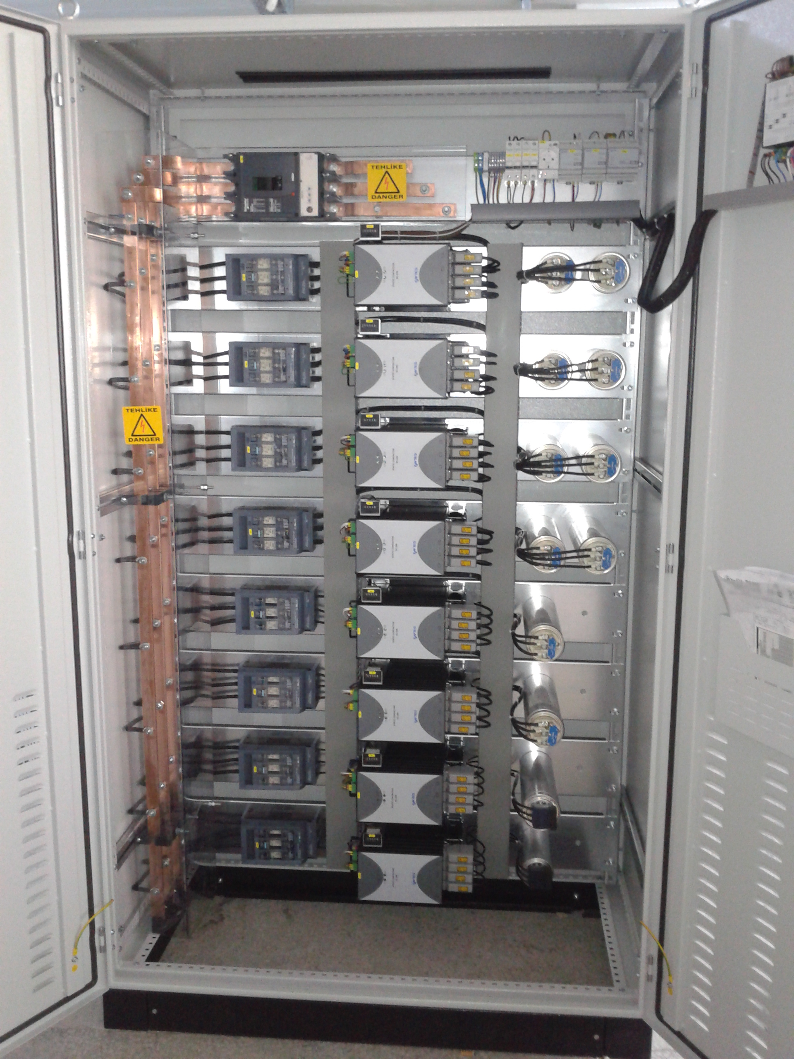
Dimensions and Usage Configuration

Slide 18
Thank You

